Slide 1
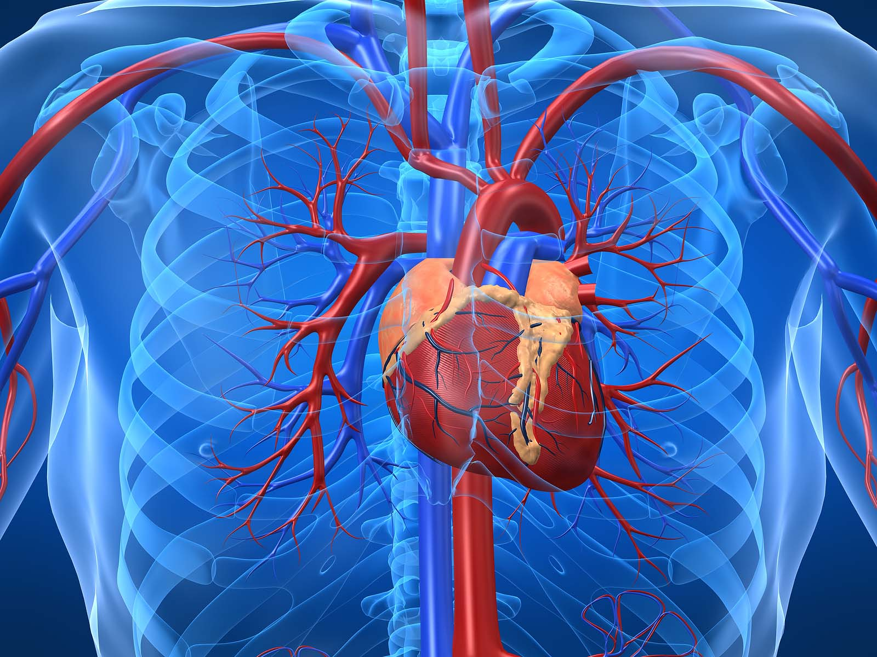
Project Team #1 Coronary Artery Disease (CAD) Predictive Model
By: Danielle Kalkofen, Ph.D., Kaddi Pham,
LaShonda Coleman, and Peggy Blaine
July 12, 2019
https://www.joshgitalis.com/wp-content/uploads/2013/01/Cardiovascular_System.jpg

Slide 2
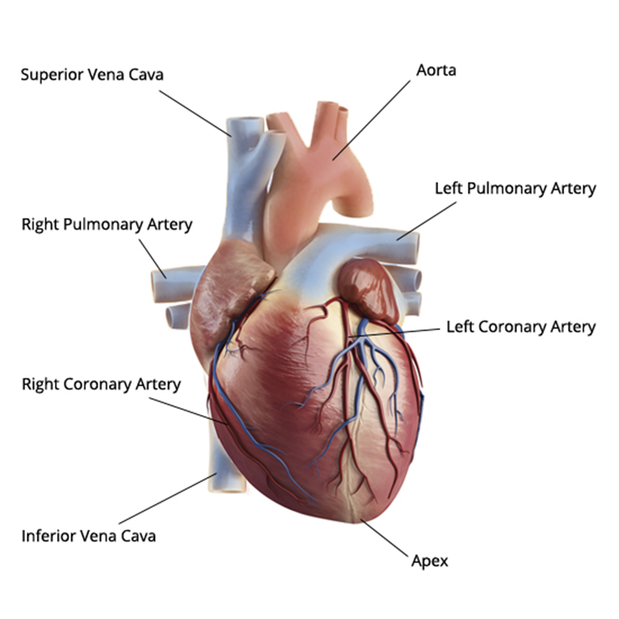
Coronary Artery Disease (CAD) Basics
It is a narrowing or blockage of arteries that provide oxygen and nutrients to the heart (see diagram on next slide). ⁽²⁾
https://leelammavarghese.files.wordpress.com/2014/06/human-heart-external-view.jpg

Slide 3
CAD Basics Continued
It is an important health topic to study, understand, and predict who is likely to develop CAD considering the following facts:
It’s the leading cause of death for both men and women in the United States. ⁽²⁾
More than 13 million Americans have active symptoms of CAD. ⁽²⁾
CAD is preventable. ⁽⁶⁾
Living a healthy lifestyle can delay the progression of CAD. ⁽⁶⁾
CAD begins early in childhood so the earlier the potential for CAD is predicted, the earlier a patient can be trained on healthy lifestyles and adopt measures that can be followed for life; significantly reducing the actual occurrence of CAD which will lead to less deaths caused by CAD. ⁽⁶⁾
CAD is also often incorrectly referred to as coronary heart disease (CHD) and heart disease, though technically, they are not the same thing. CHD is actually a result of CAD per the American Heart Association. ⁽⁷⁾

Slide 4
Proposed CAD Indicators
UCI Dataset Analysis:
Based on these 8 attributes that are indicators of heart disease, build a model: ⁽¹⁾
Age
Sex
Chest Pain (cp): typical angina or non-typical angina
Resting Blood Pressure (trestbps)
Serum Cholesterol (chol)
Fasting Blood Sugar (fbs): if > 120 mg/dl) (1 = true; 0 = false)
Resting Heart Rate (thalrest)
Exercise Induced Angina (exang): 1 = yes; 0 = no
Diagnosis of Heart Disease (num): based on angiographic disease status: < 50% diameter narrowing = 0; > 50% diameter narrowing = 1. Originally num was 0-4 with 0=no heart disease and 1-4=some form of heart disease. Changed all 1-4 values to 1=heart disease, left 0=no heart disease.
Based on relevant and current literature, verify these attributes are major indicators of heart disease. ^{(2, 3)}
Used Python to clean up data for 3 columns:
Trestbps: if == -9, set to None; use num for groupby; calculate mean trestbps; fill testbps =Nan
Chol: if == -9, set to None or if == 0, set to None; use num for groupby; calculate mean chol; fill chol =Nan
Thalrest: if == -9, set to None
Train the model to predict: who will/will not develop heart disease

Slide 5
Proposed CAD Indicators
NHANES Dataset Analysis and mapping to UCI Dataset:
Age = age
Sex = sex
Chest Pain (cp): typical angina or non-typical angina = cp
Resting Blood Pressure (trestbps) = trestbps
Serum Cholesterol (chol) = chol
LBXGLU = Fasting Blood Sugar (fbs): if > 120 mg/dl) (1 = true; 0 = false)
Resting Heart Rate (thalrest) = thalrest
CDQ002 = Exercise Induced Angina (exang): 1 = yes; 0 = no
Num = Diagnosis of Heart Disease (num): based on angiographic disease status: < 50% diameter narrowing = 0; > 50% diameter narrowing = 1. Originally num was 0-4 with 0=no heart disease and 1-4=some form of heart disease. Changed all 1-4 values to 1=heart disease, left 0=no heart disease.
Based on relevant and current literature, verify these attributes are major indicators of heart disease. ^{(2, 3)}
Used Python to clean up data for 4 columns:
‘Sex’: if != 1, set ‘Sex’=0;
‘cp’: if != 1, set ‘cp’=0,
‘CDQ002’: if != 1, set ‘CDQ002’=0 (=exang)
‘Num’ != 1, set ‘Num = 0
Use trained model to predict: who will/will not develop heart disease for NHANES dataset

Slide 6
UCI Dataset Information
Background Information Details
Datasets include 4 databases from 4 locations:
Cleveland: 282 records
Hungary: 294 records
Switzerland: 123 records
Long Beach: 200 records
Database Source Clinics and Creators:
Cleveland Clinic Foundation: Robert Detrano, M.D., Ph.D.
Hungarian Institute of Cardiology. Budapest: Andras Janosi, M.D.
Switzerland:
University Hospital, Zurich, Switzerland: William Steinbrunn, M.D.
University Hospital, Basel, Switzerland: Matthias Pfisterer, M.D.
V.A. Medical Center, Long Beach, CA: Robert Detrano, M.D., Ph.D.
Data Analyzed:
Original dataset: 920 records with 14 attributes
Cleaned dataset: 899 records with 9 attributes

Slide 7
NHANES Dataset Information
Background Information Details
Datasets include records
Database Source Clinics and Creators:
, M.D., Ph.D.
Background:
Original dataset: 10,000?? records with ?? attributes
Cleaned dataset: 646 records with 9 attributes

Slide 8
UCI Dataset Assumptions
Chose 8 attributes from the set that:
Most indicative of heart disease given our background research
Matched attributes that were measured in NHANES dataset
Age, sex, experienced chest pain, resting blood pressure, cholesterol, fasting blood sugar, resting heart rate, and experienced chest pain after exercise.
Data for experienced chest pain and CAD disease status were stratified in dataset. Simplified the data to yes/no.
Records missing experienced chest pain and experienced chest pain after exercise were dropped.
Missing values for resting blood pressure, cholesterol, fasting blood sugar and resting heart rate were replaced with mean value from age group.

Slide 9
NHANES Dataset Assumptions
Assumed that:
“Have you ever experienced chest pain?” was equivalent to simplified “experienced chest pain” attribute from UCI
“Do you experience chest pain after walking uphill or walking quickly?” was equivalent to “experienced chest pain after bicycle exercise test” attribute from UCI
Third resting systolic blood pressure measurement (from a series of 4) was equivalent to the resting systolic blood pressure measurement from UCI
“Has your doctor ever told you that you have CAD?” was equivalent to the “CAD disease status” label from UCI
Dropped records that were missing CAD disease status, experienced chest pain, and experienced chest pain after exercise
Missing values for resting blood pressure, cholesterol, fasting blood sugar, and resting heart rate were replaced with mean value from age group.

Slide 10
CAD for UCI Datasets
 | Cleveland | Long Beach | Hungary | Switzerland
No | 157 | 51 | 187 | 8
Yes | 125 | 149 | 107 | 114
No = No CAD Present
Yes = CAD Present
Switzerland has largest # CAD present

Slide 11
UCI vs NHANES CAD
 | UCI | NHANES
No | 403 | 550
Yes | 495 | 96
No = No CAD Present
Yes = CAD Present
NHANES Dataset has MUCH LESS CAD

Slide 12
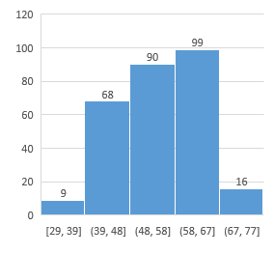
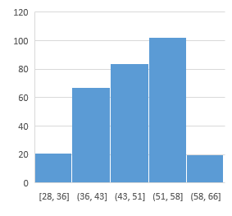
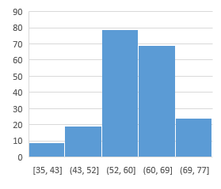
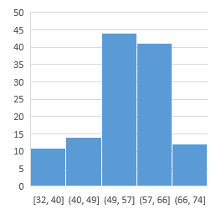
Age Distribution Per UCI Datasets
Cleveland | Long Beach | Hungary | Switzerland
All 4 databases in UCI dataset have fairly similar age distributions

Slide 13
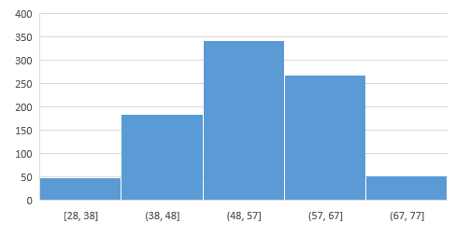
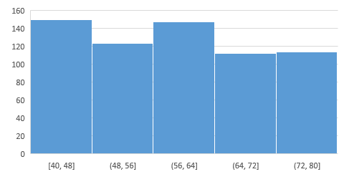
UCI vs NHANES Age Distribution
UCI | NHANES
NHANES dataset age distributed over 40 years (from 40 to 80 years old) while UCI dataset has bell curve with 49 years age distribution (from 28 to 77 years old).

Slide 14

Predictive Model: Random Forest Classifier ⁽⁷⁻¹²⁾
Collection of individual and independent decision trees (aka the “forest”)
For a given object, each tree in the forest independently classifies the object
Final classification of the object is the majority vote from the forest
https://www.maiafinancial.com.au/wp-content/uploads/2016/09/iStock-506856658-resize-2mb-1024x682.jpg

Slide 15
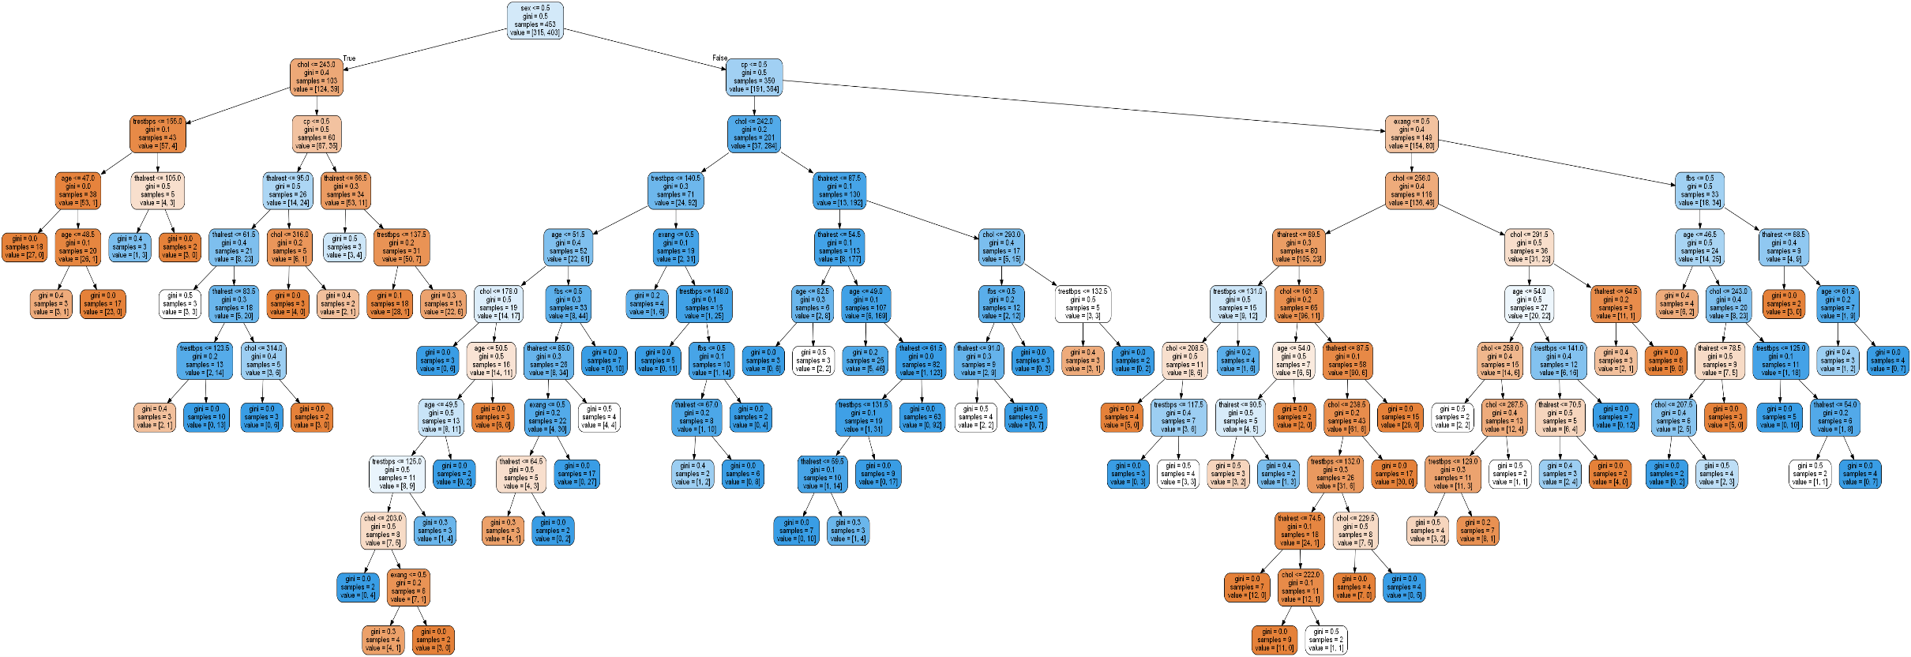
Tree #5 from Random Forest

Slide 16
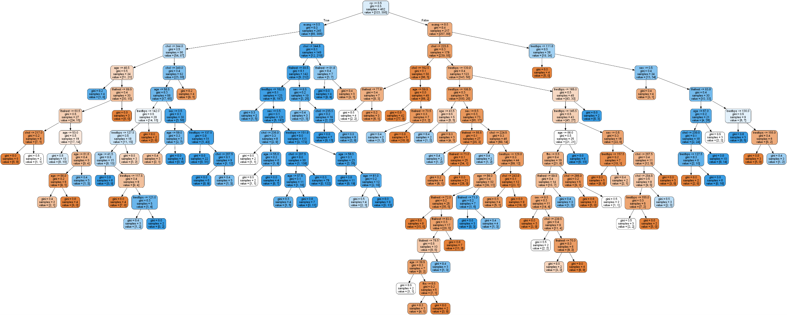
Tree #500 from Random Forest

Slide 17
Why Use a Random Forest Classifier? ⁽⁷⁻¹²⁾
Pros:
Non-parametric: can use on data where true incidence or distribution of the variables is unknown.
Works for data with both categorical and numerical data (binary and continuous data).
Versus a Single Decision Tree
Reduces risk of model overfitting
More stable/robust—better able to handle dataset variation
Cons:
Depending on complexity of dataset, algorithm can be computationally expensive.

Slide 18
Results of Predictive Model Testing
UCI Training Dataset | NHANES Dataset

Slide 19
CAD Predictive Model: Conclusions
Successful implementation:
Recently published medical AI are achieving 80-90% accuracy. ⁽¹³⁻¹⁴⁾
Our model has 80% accuracy in predicting the individuals with CAD.
Acceptable accuracy given model uses only 9 physiological attributes known to indicate heart health risk. The original UCI dataset contained 74 attributes but we had to whittle that list down to just 9 in order to find good datasets to use for training and testing the model.
Successful but not without compromise:
NHANES dataset is skewed due to differences in age distribution and disease status. This occurred because we had to remove rows of data for patients under 40 because several measurements for these patients were not recorded.
Differences in terminology caused us to make some assumptions about the NHANES dataset. The fewer the assumptions we have to make, the better the test.

Slide 20
CAD Predictive Model: Further Study
Additional Study: Ideas for Improvement
Used the 2013-2014 NHANES data to test our model. There are many more datasets spanning from 2016-2017 back to 1959-1962.
Assure accuracy of model if could test with other sources of CAD-related datasets.
Determine if there are additional or better parameters (attributes) to incorporate into the model to improve accuracy (assuming data could be obtained).
UCI dataset had 74 different parameters; used only 9 in order to match other datasets.
Including CAD and Diabetes family history and smoking habits would improve model.
Additional Study: Use Datasets That Match More Closely
NHANES dataset was missing cardiac-specific measurements for patients under 40 years old.
Had to discard a large proportion of the dataset. It would be better if our datasets matched age distribution better.
Differences in terminology made it difficult to match parameters/attributes from different datasets so the study would be better if those differences were removed.

Slide 21
References
Detrano, Robert, MD, PhD; Janosi, Andras, MD; Steinbrunn, Walter, MD; Pfisterer, Matthias, MD; Schmid, Johann-Jakob, DE; Sandhu, Sarbjit, MD; Guppy, Kern H, PhD; Lee, Stella, MS; Froelicher, Victor, MD. (1989, Aug). “International Application of a New Probability Algorithm for the Diagnosis of Coronary Artery Disease”. The American Journal of Cardiology, Volume 64, Issue 5, pp: 304-310.
Coronary Artery Disease. (n.d.) The Free Dictionary web site. Retrieved 7/11/2019 from https://medical-dictionary.thefreedictionary.com/coronary+artery+disease
University of California, Irvine (UCI) Heart Disease Dataset. (2016). Retrieved 7/8/2019 from https://data.world/uci/heart-disease
National Health and Nutrition Examination Survey (NHANES) Dataset. (2013-2014). Retrieved 7/8/2019 from https://www.kaggle.com/cdc/national-health-and-nutrition-examination-survey
Center for Disease Control and Prevention. National Center for Health Statistics NHANES Questionnaires, Datasets, and Related Documentation. (1959-2020). Retrieved 7/8/2019 from https://wwwn.cdc.gov/Nchs/Nhanes/Default.aspx
Coronary Artery Disease. (n.d.) Heart.org web site by The American Heart Association. Retrieved 7/8/2019 from https://www.heart.org/en/health-topics/consumer-healthcare/what-is-cardiovascular-disease/coronary-artery-disease

Slide 22
References
Random Forest Algorithm with Python and Scikit-Learn (6/13/2018, by Usman Malik). Stack Abuse website. Retrieved 7/8/2019: https://stackabuse.com/random-forest-algorithm-with-python-and-scikit-learn/
Implementing a Random Forest Classification Model in Python (5/18/2018, by Jake Huneycutt). Medium website. Retrieved 7/8/2019: https://medium.com/@hjhuney/implementing-a-random-forest-classification-model-in-python-583891c99652
Random Forest in Python (12/27/2017 by Will Koehrsen). Towards Data Science website. Retrieved 7/8/2019: https://towardsdatascience.com/random-forest-in-python-24d0893d51c0
In-Depth: Decision Trees and Random Forests (n.d.) Python Data Science Handbook website by Jake VanderPlas. Retrieved 7/8/2019: https://jakevdp.github.io/PythonDataScienceHandbook/05.08-random-forests.html
A Gentle Introduction to Random Forests, Ensembles, and Performance Metrics in a Commercial System (11/9/2012 by Dan Benyamin). CitizenNet Blog website. Retrieved 7/8/2019: http://blog.citizennet.com/blog/2012/11/10/random-forests-ensembles-and-performance-metrics
Random Forests Explained Intuitively (n.d., by Manish Barnwal). KD Nuggets website. Retrieved 7/8/2019: https://www.kdnuggets.com/2019/01/random-forests-explained-intuitively.html
A.I. Shows Promise Assisting Physicians (2/11/2019, by Cade Metz). New York Times website. Retrieved 7/12/2019: https://www.nytimes.com/2019/02/11/health/artificial-intelligence-medical-diagnosis.html
Top Smart Algorithms in Healthcare (2/5/2019, by unknown). The Medical Futurist website. Retrieved 7/12/2019: https://medicalfuturist.com/top-ai-algorithms-healthcare

